Slide 1
Kai Kaletsch
Environmental Instruments Canada Inc.
Kai@eic.nu
Radon-in-Water
and Thoron Measurements
with a Radon Sniffer

Slide 2
Radon Sniffers can be used for:
Locating radon entry points
Checking for the presence of Thoron (Radon-220)
Radon in water screening

Slide 3
Why measure Thoron (Rn-220)?
Contributes to lung dose
Can affect the accuracy of the radon sniffer algorithm

Slide 4
Thoron (Rn-220) needs to be measured:
Close to the source:
– Below slab
– Entry point

Slide 5
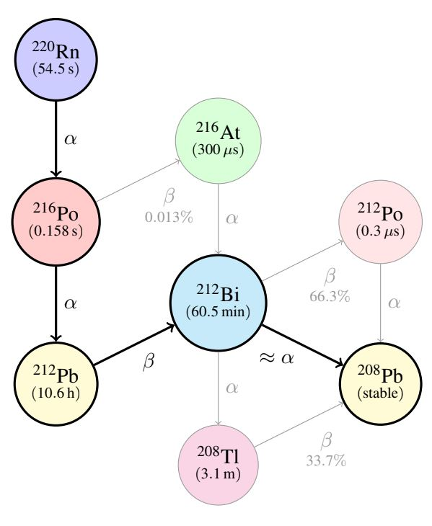
How the activity from Thoron (Rn-220) changes over time:

Slide 6
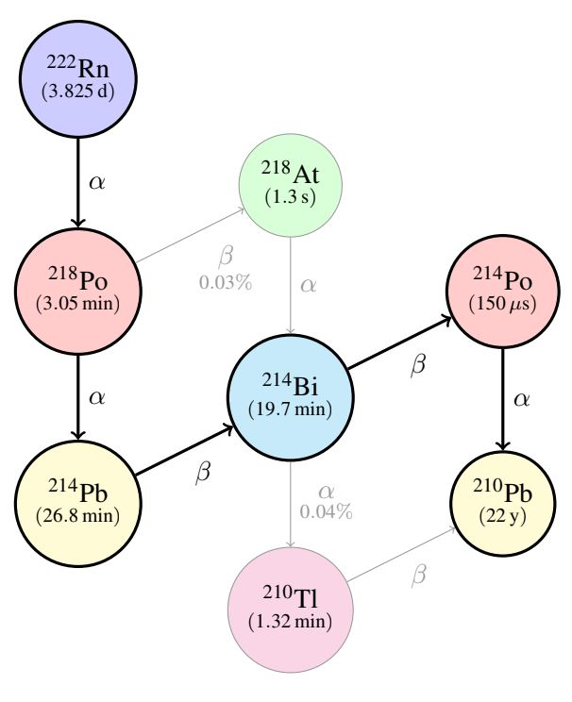
How the activity from Radon-222 changes over time:

Slide 7
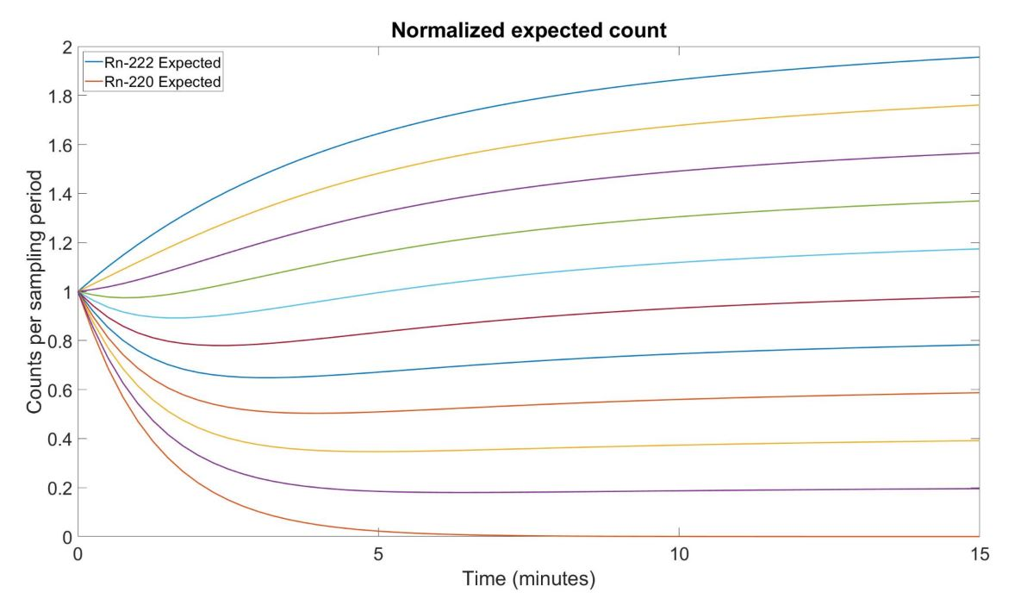

Slide 8
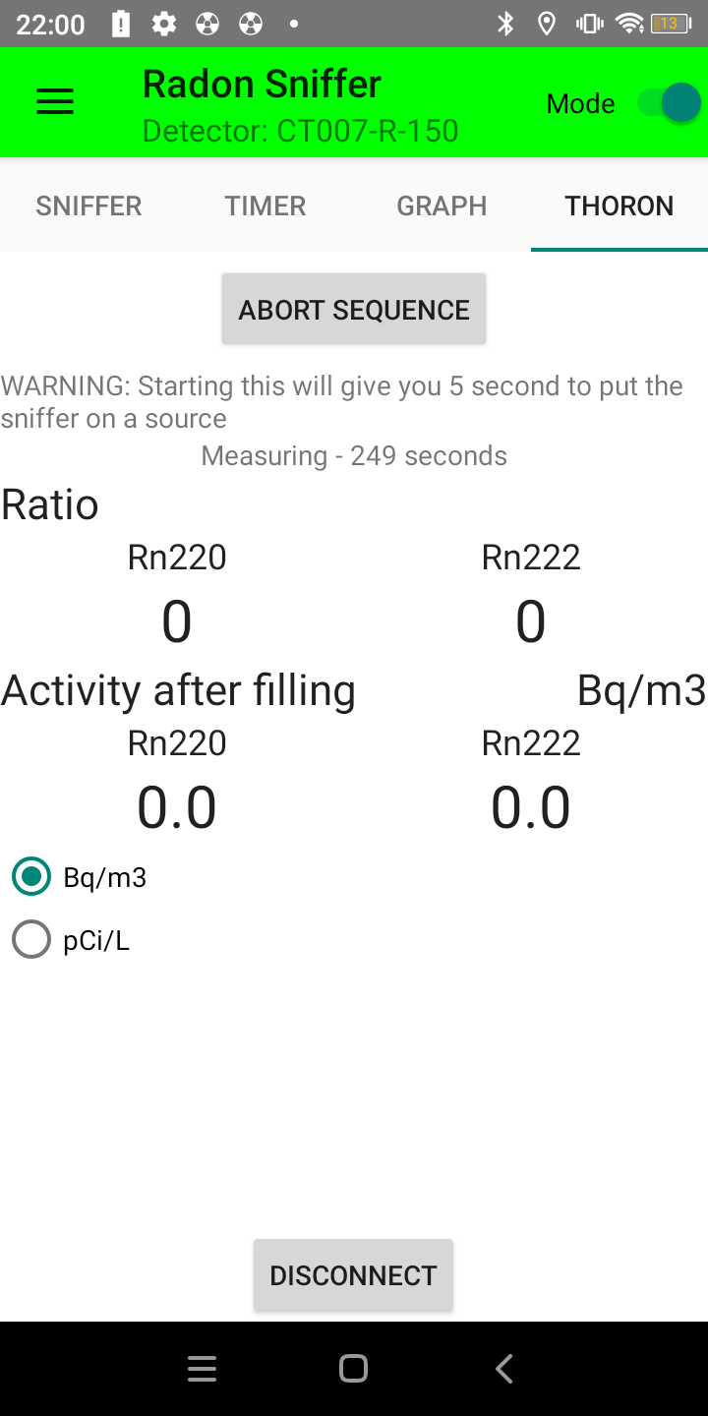
Thoron Sequence
5 seconds to get into a source
90 seconds of filling
300 seconds of measuring the activity
with the pump off

Slide 9
Why measure Radon in water with a Sniffer?
Guidelines for well water
Allows a measurement in ≈ 10 min

Slide 10
How to measure Radon in water with a Sniffer:
Continually bubble air through water sample
Measure Radon concentration in air
Radon concentration in water =
Radon concentration in air x total volume / water volume

Slide 11
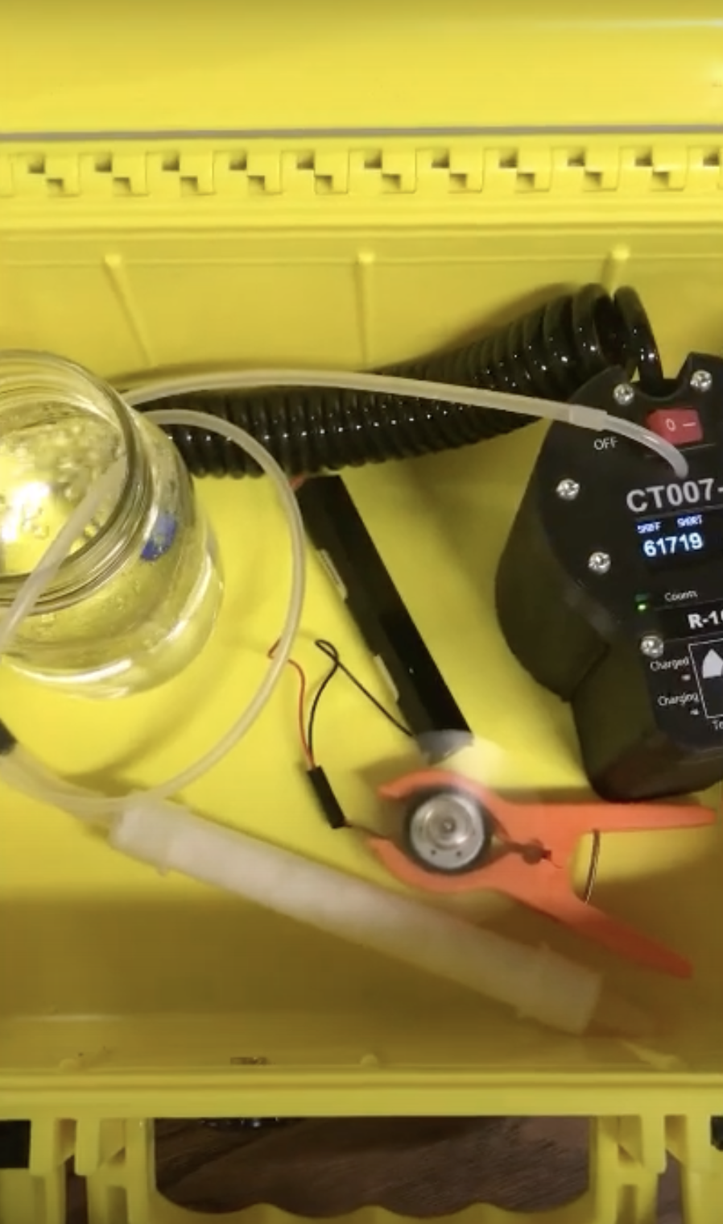
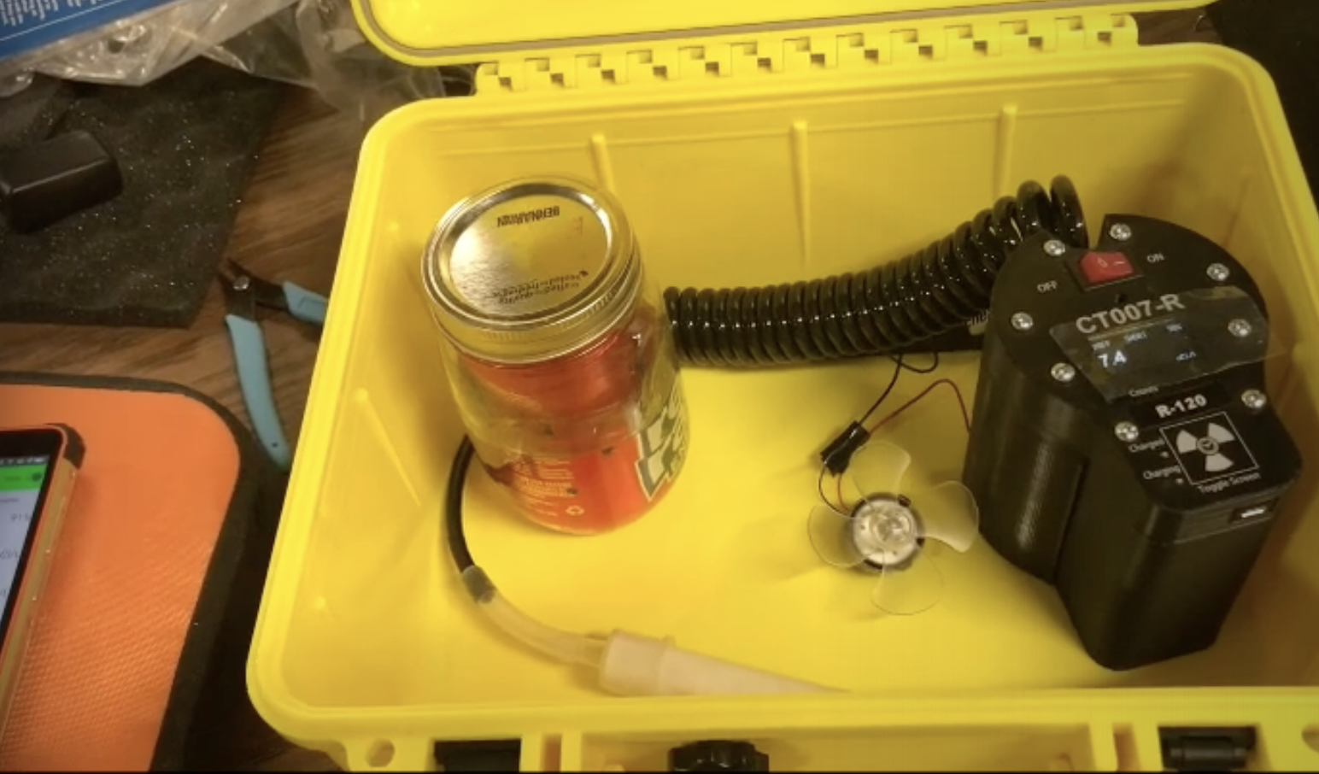

Slide 12
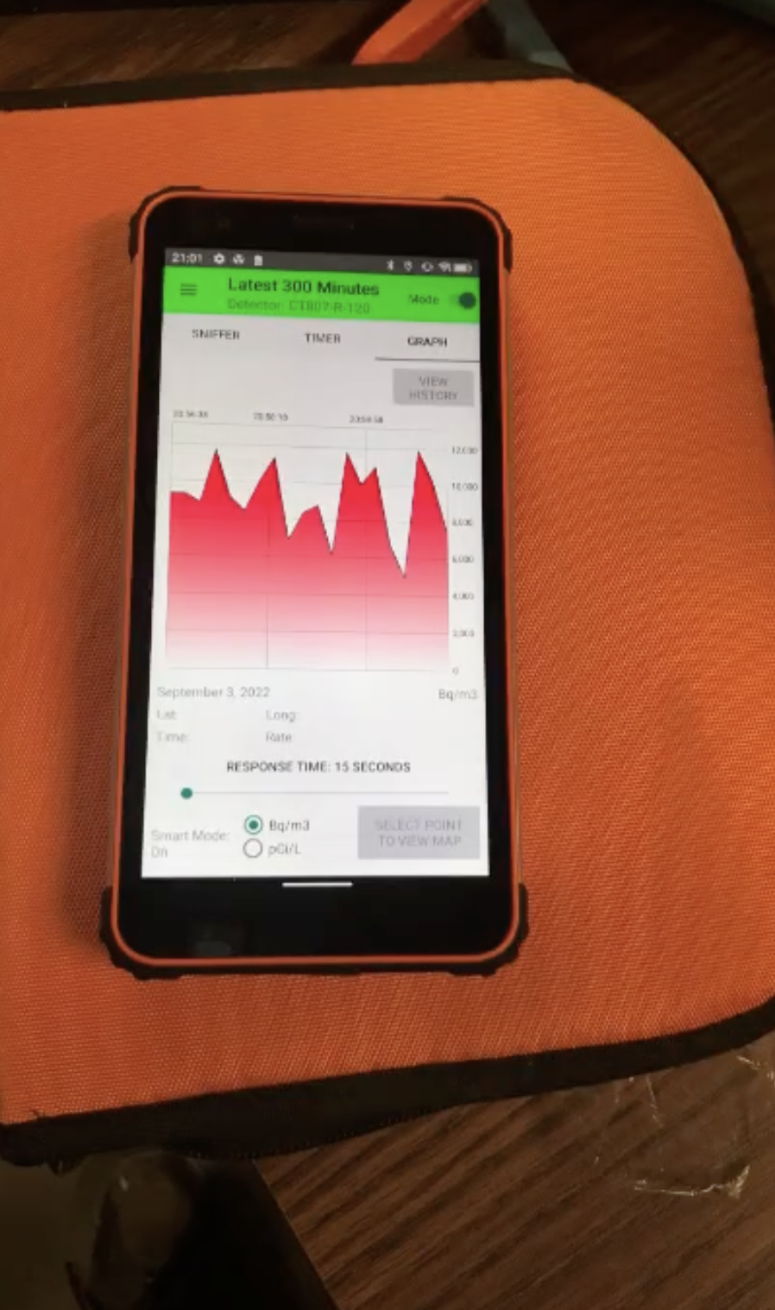
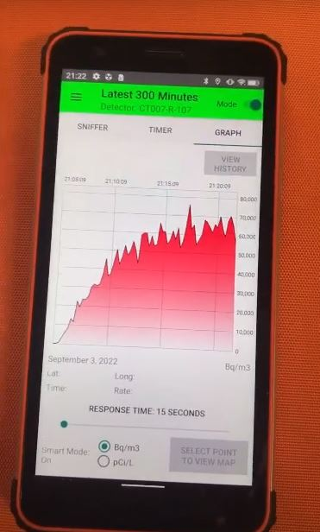
Without bubbling air through the sample the air concentration in the case levels out at around 275 pCi/L.
With bubbling air through the water sample, the air concentration in the case levels out at around 1700 pCi/L in about 10 minutes.
That corresponds to about 60 000 pCi/L in the water sample.

Slide 13
Thanks for listening.
Any questions?
Contact me at kai@eic.nu

